Slide 1
C4.5 Algorithm
Decision Tree Learning

Slide 2
Introduction
ID3 is the most common conventional decision tree algorithm but it has bottlenecks.
Attributes must be nominal values.
Dataset must not include missing data.
The algorithm tend to fall into over-fitting.
Ross Quinlan, inventor of ID3, made some improvements for these bottlenecks and created a new algorithm named C4.5.
The algorithm can create a more generalized models including continuous data and could handle missing data.
some resources such as Weka named this algorithm as J48.
Actually, it refers to re-implementation of C4.5 release 8.

Slide 3
Objective
Decision rules will be found based on entropy and information gain ratio pair of each feature.
In each level of decision tree, the feature having the maximum gain ratio will be the decision rule.

Slide 4
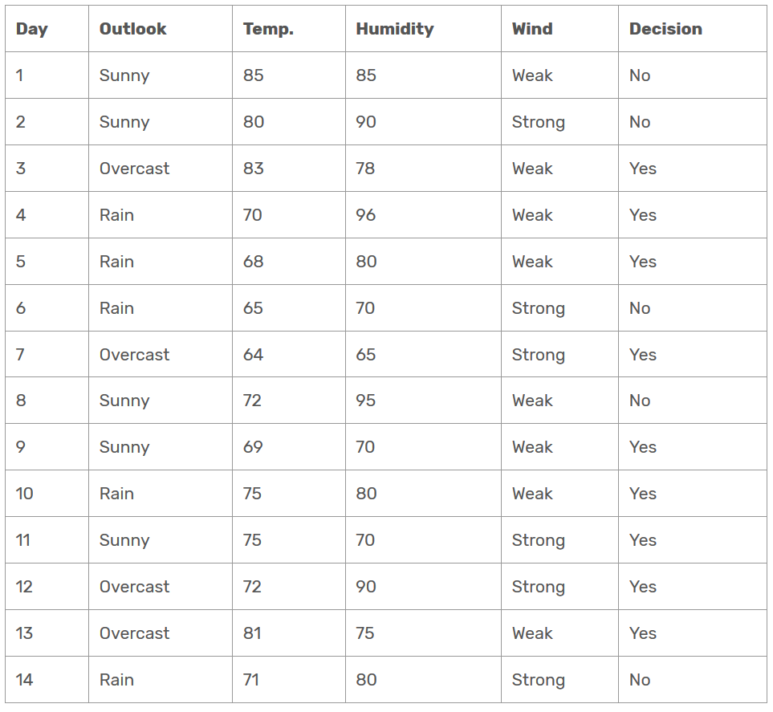
Data set
We are going to create a decision table for the given dataset. It informs about decision making factors to play tennis at outside for previous 14 days. The dataset might be familiar from the ID3 and CART example. The difference is that temperature and humidity columns have continuous values instead of nominal ones.

Slide 5
Solution
Firstly, we need to calculate global entropy.
There are 14 examples; 9 instances refer to yes decision, and 5 instances refer to no decision.
Entropy(Decision) =∑ – p(I) . log₂p(I) = – p(Yes) . log₂p(Yes) – p(No) . log₂p(No) = – (9/14) . log₂(9/14) – (5/14) . log₂(5/14) = 0.940

Slide 6
Gain Ratio
In ID3 algorithm, we’ve calculated gains for each attribute. Here, we need to calculate gain ratios instead of gains.
GainRatio(A) = Gain(A) / SplitInfo(A)
SplitInfo(A) = -∑ |Dj|/|D| x log₂|Dj|/|D|

Slide 7
Wind Attribute
Wind is a nominal attribute. Its possible values are weak and strong.
Gain(Decision, Wind) = Entropy(Decision) – ∑ ( p(Decision|Wind) . Entropy(Decision|Wind) )
Gain(Decision, Wind) = Entropy(Decision)
– p(Decision|Wind=Weak) . Entropy(Decision|Wind=Weak)
– p(Decision|Wind=Strong) . Entropy(Decision|Wind=Strong)
There are 8 weak wind instances. 2 of them are concluded as no, 6 of them are concluded as yes.
Entropy(Decision|Wind=Weak) = – p(No) . log₂p(No) – p(Yes) . log₂p(Yes) = – (2/8) . log₂(2/8) – (6/8) . log₂(6/8) = 0.811
Entropy(Decision|Wind=Strong) = – (3/6) . log₂(3/6) – (3/6) . log₂(3/6) = 1
Gain(Decision, Wind) = 0.940 – (8/14).(0.811) – (6/14).(1) = 0.940 – 0.463 – 0.428 = 0.049
There are 8 decisions for weak wind, and 6 decisions for strong wind.
SplitInfo(Decision, Wind) = -(8/14).log₂(8/14) – (6/14).log₂(6/14) = 0.461 + 0.524 = 0.985
GainRatio(Decision, Wind) = Gain(Decision, Wind) / SplitInfo(Decision, Wind) = 0.049 / 0.985 = 0.049

Slide 8
Outlook Attribute
Outlook is a nominal attribute, too. Its possible values are sunny, overcast and rain.
Gain(Decision, Outlook) = Entropy(Decision) – ∑ ( p(Decision|Outlook) . Entropy(Decision|Outlook) )
Gain(Decision, Outlook) = Entropy(Decision) – p(Decision|Outlook=Sunny) . Entropy(Decision|Outlook=Sunny) – p(Decision|Outlook=Overcast) . Entropy(Decision|Outlook=Overcast) – p(Decision|Outlook=Rain) . Entropy(Decision|Outlook=Rain)
There are 5 sunny instances. 3 of them are concluded as no, 2 of them are concluded as yes.
Entropy(Decision|Outlook=Sunny) = – p(No) . log₂p(No) – p(Yes) . log₂p(Yes) = -(3/5).log₂(3/5) – (2/5).log₂(2/5) = 0.441 + 0.528 = 0.970
Entropy(Decision|Outlook=Overcast) = – p(No) . log₂p(No) – p(Yes) . log₂p(Yes) = -(0/4).log₂(0/4) – (4/4).log₂(4/4) = 0
Entropy(Decision|Outlook=Rain) = – p(No) . log₂p(No) – p(Yes) . log₂p(Yes) = -(2/5).log₂(2/5) – (3/5).log₂(3/5) = 0.528 + 0.441 = 0.970
Gain(Decision, Outlook) = 0.940 – (5/14).(0.970) – (4/14).(0) – (5/14).(0.970) = 0.246
There are 5 instances for sunny, 4 instances for overcast and 5 instances for rain.
SplitInfo(Decision, Outlook) = -(5/14).log₂(5/14) -(4/14).log₂(4/14) -(5/14).log₂(5/14) = 1.577
GainRatio(Decision, Outlook) = Gain(Decision, Outlook)/SplitInfo(Decision, Outlook) = 0.246/1.577 = 0.155

Slide 9
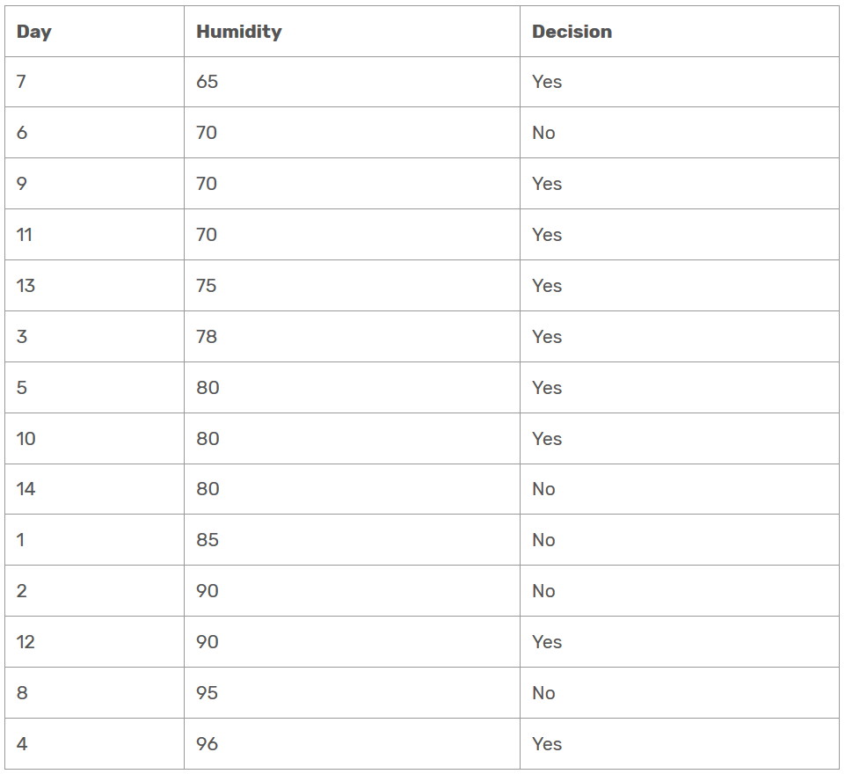
Humidity Attribute
As an exception, humidity is a continuous attribute.
We need to convert continuous values to nominal ones.
C4.5 proposes to perform binary split based on a threshold value.
Threshold should be a value which offers maximum gain for that attribute.
Let’s focus on humidity attribute. Firstly, we need to sort humidity values smallest to largest.

Slide 10
Humidity Attribute
Now, we need to iterate on all humidity values and separate dataset into two parts as instances less than or equal to current value, and instances greater than the current value.
We would calculate the gain or gain ratio for every step.
The value which maximizes the gain would be the threshold.

Slide 11
Humidity Attribute
Check 65 as a threshold for humidity
Entropy(Decision|Humidity<=65) = – p(No) . log₂p(No) – p(Yes) . log₂p(Yes) = -(0/1).log₂(0/1) – (1/1).log₂(1/1) = 0
Entropy(Decision|Humidity>65) = -(5/13).log₂(5/13) – (8/13).log₂(8/13) =0.530 + 0.431 = 0.961
Gain(Decision, Humidity<> 65) = 0.940 – (1/14).0 – (13/14).(0.961) = 0.048
The statement above refers to that what would branch of decision tree be for less than or equal to 65, and greater than 65. It does not refer to that humidity is not equal to 65!
SplitInfo(Decision, Humidity<> 65) = -(1/14).log₂(1/14) -(13/14).log₂(13/14) = 0.371
GainRatio(Decision, Humidity<> 65) = 0.126

Slide 12
Humidity Attribute
Check 70 as a threshold for humidity
Entropy(Decision|Humidity<=70) = – (1/4).log₂(1/4) – (3/4).log₂(3/4) = 0.811
Entropy(Decision|Humidity>70) = – (4/10).log₂(4/10) – (6/10).log₂(6/10) = 0.970
Gain(Decision, Humidity<> 70) = 0.940 – (4/14).(0.811) – (10/14).(0.970) = 0.940 – 0.231 – 0.692 = 0.014
SplitInfo(Decision, Humidity<> 70) = -(4/14).log₂(4/14) -10/14).log₂(10/14) = 0.863
GainRatio(Decision, Humidity<> 70) = 0.016

Slide 13
Humidity Attribute
Check 75 as a threshold for humidity
Entropy(Decision|Humidity<=75) = – (1/5).log₂(1/5) – (4/5).log₂(4/5) = 0.721
Entropy(Decision|Humidity>75) = – (4/9).log₂(4/9) – (5/9).log₂(5/9) = 0.991
Gain(Decision, Humidity<> 75) = 0.940 – (5/14).(0.721) – (9/14).(0.991) = 0.940 – 0.2575 – 0.637 = 0.045
SplitInfo(Decision, Humidity<> 75) = -(5/14).log₂(4/14) -(9/14).log₂(10/14) = 0.940
GainRatio(Decision, Humidity<> 75) = 0.047

Slide 14
Humidity Attribute
I think calculation demonstrations are enough. Now, I skip the calculations and write only results.
Gain(Decision, Humidity <> 78) =0.090, GainRatio(Decision, Humidity <> 78) =0.090
Gain(Decision, Humidity <> 80) = 0.101,
GainRatio(Decision, Humidity <> 80) = 0.107
Gain(Decision, Humidity <> 85) = 0.024,
GainRatio(Decision, Humidity <> 85) = 0.027
Gain(Decision, Humidity <> 90) = 0.010,
GainRatio(Decision, Humidity <> 90) = 0.016
Gain(Decision, Humidity <> 95) = 0.048,
GainRatio(Decision, Humidity <> 95) = 0.128
Here, I ignore the value 96 as threshold because humidity cannot be greater than this value.
As seen, gain maximizes when threshold is equal to 80 for humidity. This means that we need to compare other nominal attributes and comparison of humidity to 80 to create a branch in our tree.

Slide 15
Temperature Attribute
Temperature feature is continuous as well. When I apply binary split to temperature for all possible split points, the following decision rule maximizes for both gain and gain ratio.
Gain(Decision, Temperature <> 83) = 0.113,
GainRatio(Decision, Temperature<> 83) = 0.305

Slide 16
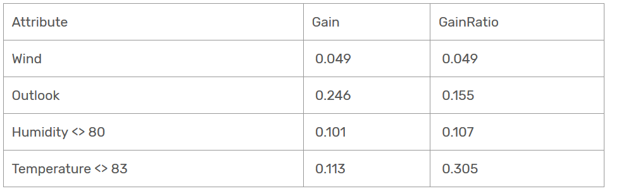
Time to decide
If we will use gain metric as in ID3, then outlook will be the root node because it has the highest gain value.
On the other hand, if we use gain ratio metric, then temperature will be the root node because it has the highest gain ratio value.

Slide 17
Root Node
Temperature
<83
=83
>83
?
?
?

Slide 18
For temperature = 83, there is single example.
Decision related to temperature = 83 is Yes.
It will be a leaf node.

Slide 19
For Temperature >83, there is one example.
Decision related to example is No.
It will be a leaf node.

Slide 20
Root Node
Temperature
<83
=83
>83
?
Yes
No

Slide 21
Second Level (Temperature < 83)
Compute the gain ration for weather, wind and humidity.
Number of examples correspond to temperature <83 are 12.
Out of 12 examples, 8 instances refer to yes decision, and 4 instances refer to no decision.
Entropy(decision | temp<83) =∑ – p(I) . log₂p(I) = – p(Yes) . log₂p(Yes) – p(No) . log₂p(No) = – (8/12) . log₂(8/12) – (4/12) . log₂(4/12) = 0.39+0.53= 0.92

Slide 22
Second Level (Temperature < 83) Wind Attribute
Wind is a nominal attribute. Its possible values are weak and strong.
There are 6 weak wind instances. 1 of them are concluded as no, 5 of them are concluded as yes.
Entropy(temp<83 |Wind=Weak) = – p(No) . log₂p(No) – p(Yes) . log₂p(Yes) = – (1/6) . log₂(1/6) – (5/6) . log₂(5/6) = 0.43+0.22= 0.65
Entropy(temp<83 |Wind=Strong) = – (3/6) . log₂(3/6) – (3/6) . log₂(3/6) = 1
Gain(temp<83, Wind) = 0.92 – (6/12).(0.65) – (6/12).(1) = 0.095
There are 6 decisions for weak wind, and 6 decisions for strong wind.
SplitInfo(temp<83, Wind) = -(6/12).log₂(6/12) – (6/12).log₂(6/12) = 0.5 + 0.5 = 1
GainRatio(temp<83, Wind) = Gain(temp<83, Wind) / SplitInfo(temp<83, Wind) = 0.095 / 1 = 0.095

Slide 23
Outlook Attribute
Outlook is a nominal attribute, too. Its possible values are sunny, overcast and rain.
Gain(Decision, Outlook) = Entropy(Decision) – ∑ ( p(Decision|Outlook) . Entropy(Decision|Outlook) )
Gain(Decision, Outlook) = Entropy(Decision) – p(Decision|Outlook=Sunny) . Entropy(Decision|Outlook=Sunny) – p(Decision|Outlook=Overcast) . Entropy(Decision|Outlook=Overcast) – p(Decision|Outlook=Rain) . Entropy(Decision|Outlook=Rain)
There are 4 sunny instances. 2 of them are concluded as no, 2 of them are concluded as yes.
There are 3 overcast instances. All 3 are concluded as yes.
There are 5 rainy instances. 2 of them are concluded as no, 2 of them are concluded as yes.
Entropy(temp<83|Outlook=Sunny) = – p(No) . log₂p(No) – p(Yes) . log₂p(Yes) = -(2/4).log₂(2/4) – (2/4).log₂(2/4) = 0.5 + 0.5 = 1
Entropy(temp<83|Outlook=Overcast) = – p(No) . log₂p(No) – p(Yes) . log₂p(Yes) = -(0/4).log₂(0/4) – (4/4).log₂(4/4) = 0
Entropy(temp<83|Outlook=Rain) = – p(No) . log₂p(No) – p(Yes) . log₂p(Yes) = -(2/5).log₂(2/5) – (3/5).log₂(3/5) = 0.528 + 0.441 = 0.970
Gain(temp<83, Outlook) = 0.92 – (4/12).(1) – (3/12).(0) – (5/12).(0.970) = 0.18
There are 4 instances for sunny, 3 instances for overcast and 5 instances for rain.
SplitInfo(temp<83, Outlook) = -(4/12).log₂(4/12) -(3/12).log₂(3/12) -(5/12).log₂(5/12) = 0.53+0.5+0.53= 1.56
GainRatio(temp<83, Outlook) = Gain(temp<83, Outlook)/SplitInfo(temp<83, Outlook) = 0.18/1.56 = 0.11

Slide 24
Exercise: Second Level (Temperature < 83) Humidity
Compute gain ratio for humidity considering threshold = 80.

Slide 25
Conclusion
C4.5 algorithm uses gain ratios instead of gains.
In this way, it creates more generalized trees and not to fall into overfitting.
Moreover, the algorithm transforms continuous attributes to nominal ones based on gain maximization.
Additionally, it can ignore instances including missing data and handle missing dataset.
On the other hand, both ID3 and C4.5 requires high CPU and memory demand.

Slide 26
Thank You !!!

